Slide 1

Module 4
Deep Learning: AutoEncoders
Notes:
Guidelines
Use section headers to chunk content in your presentation.
Use the same style of section header throughout your presentation.
Keep your title to no more than 2 lines.

Slide 2
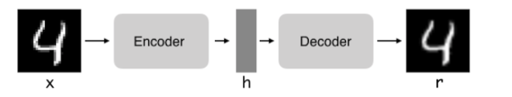
DL: AutoEncoders
Notes:
Guidelines
Use a title slide at the beginning of your presentation. There are 9 variations of title slides to choose from.
If you will have a series of slideshows, we recommend using the same style of title slide for each presentation.
Keep your title to no more than 2 lines.
Do not change the font style or font size of the title or subtitle.

Slide 3
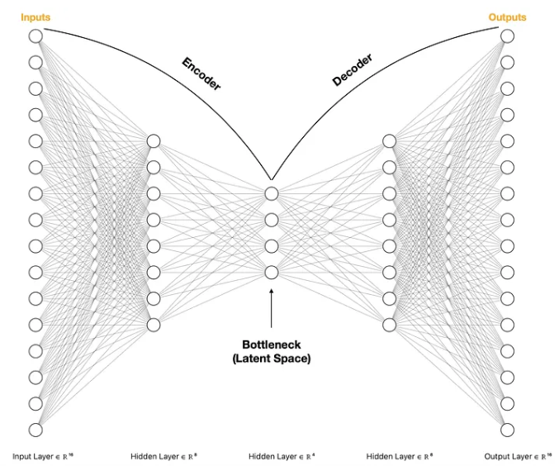
AutoEncoders
Unsupervised learning NN architecture used to learn data codings
Trained to reconstruct input data after compression
Learns two functions: Encoder and Decoder

Slide 4
AutoEncoders
Encoder: transforms the input data to a lower dimension
Decoder: recreates the input data.

Slide 5
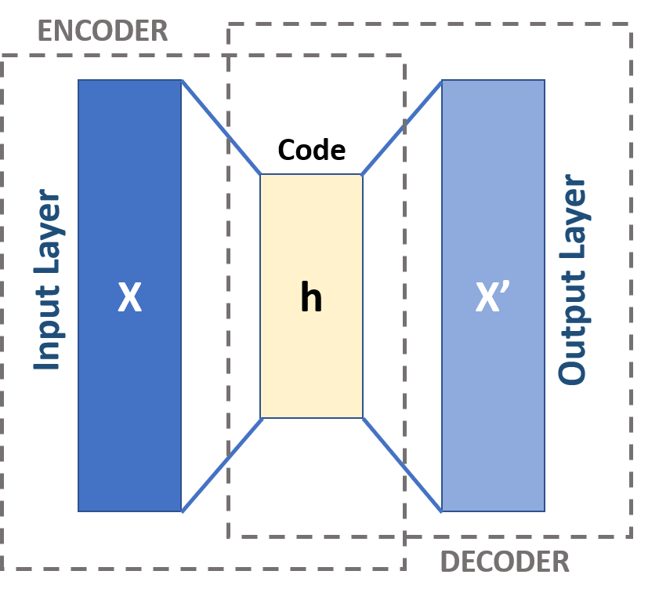
Schema of an AutoEncoder
Input and Output layers have the same neurons (input vars)
Encoder maps the message to a code (latent space or bottleneck)
Decoder reconstructs the code

Slide 6
Layers
Between encoder and decoder, the layer(s) act as a bottleneck
Compressed knowledge representation of the original input
The compressed data is also called the latent space

Slide 7
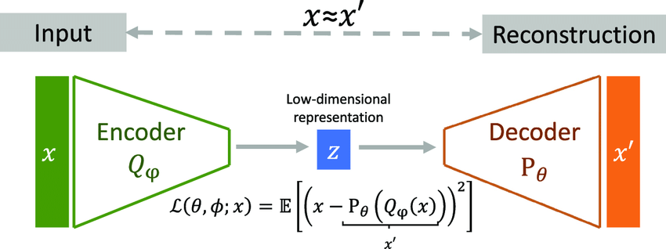
AutoEncoders
Goal of autoencoder is to recreate the input values
The reconstruction loss measures how good the autoencoder is

Slide 8
Why use AutoEncoders?
Dimension reduction
Noise reduction (denoising)
Anomaly detection
Feature extraction

Slide 9
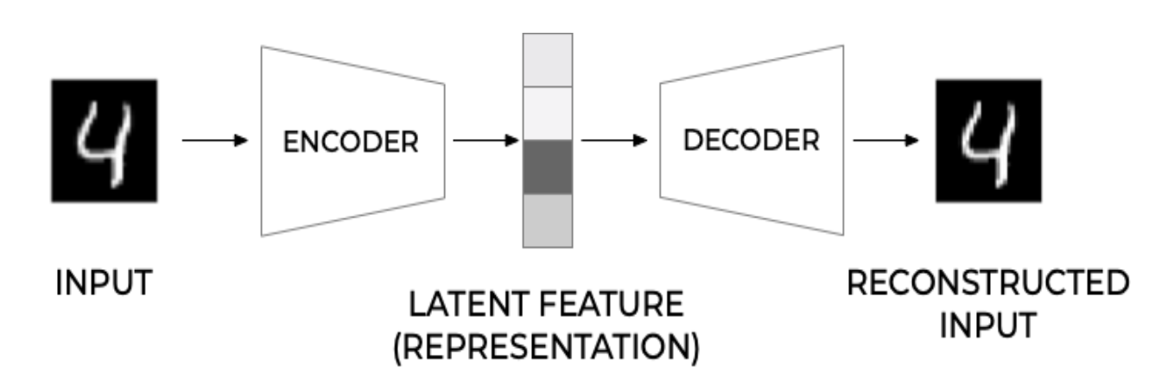

Mathematical Formulation
Encoder: $h = g(x)$
Decoder: $f$
Reconstruction: $\tilde{x}=f(h)$
Loss: Minimize Cost Function (MSE or Binary Cross-Entropy)

Slide 10
Dimensionality Reduction
Bottleneck: Latent space has lower dimension than inpu
Latent space also captures key features
Autoencoders outperform PCA on large or nonlinear data

Slide 11

Reconstruction Error
Difference between the original input $x$ and reconstructed $\tilde{x}$.
The observation MSE reconstruction error is:
$MSE_{i}= \frac{1}{k}{\left\|x−\tilde{x}\right\|}_{2}^{2}$

Slide 12
Types of AutoEncoders
Notes:
Guidelines
Use a title slide at the beginning of your presentation. There are 9 variations of title slides to choose from.
If you will have a series of slideshows, we recommend using the same style of title slide for each presentation.
Keep your title to no more than 2 lines.
Do not change the font style or font size of the title or subtitle.

Slide 13
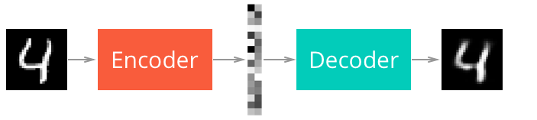
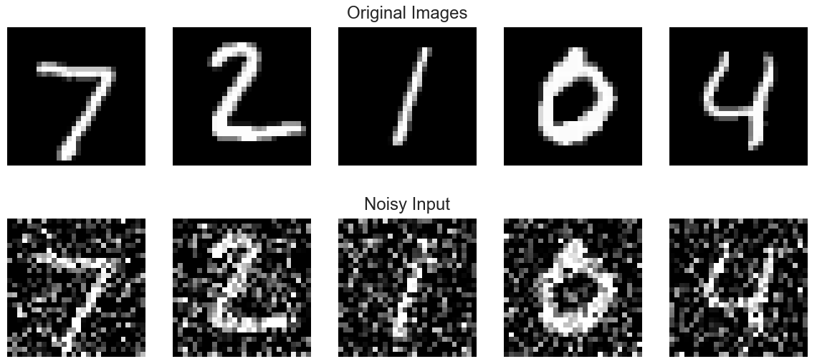
Types of AutoEncoders
There are many types of autoencoders, we will focus on:
Undercomplete autoencoders
Sparse autoencoders
Denoising autoencoders

Slide 14
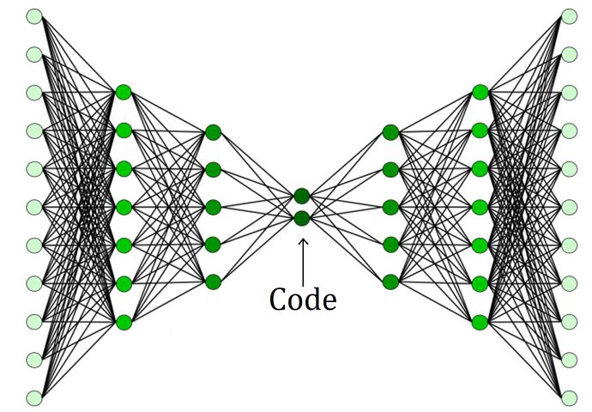

Deep AutoEncoders (Undercomplete)
Take an input and predicts it as output.
Using multiple hidden layers we call these deep autoencoders.

Slide 15
Python
Notes:
Guidelines
Use a title slide at the beginning of your presentation. There are 9 variations of title slides to choose from.
If you will have a series of slideshows, we recommend using the same style of title slide for each presentation.
Keep your title to no more than 2 lines.
Do not change the font style or font size of the title or subtitle.

Slide 16
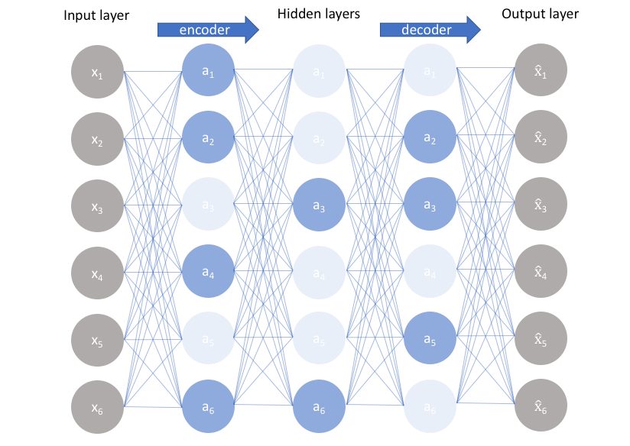
Sparse AutoEncoders
Autoencoder with a sparsity penalty
Common sparsity penalties include L1 and L2 norms

Slide 17
Python
Notes:
Guidelines
Use a title slide at the beginning of your presentation. There are 9 variations of title slides to choose from.
If you will have a series of slideshows, we recommend using the same style of title slide for each presentation.
Keep your title to no more than 2 lines.
Do not change the font style or font size of the title or subtitle.

Slide 18
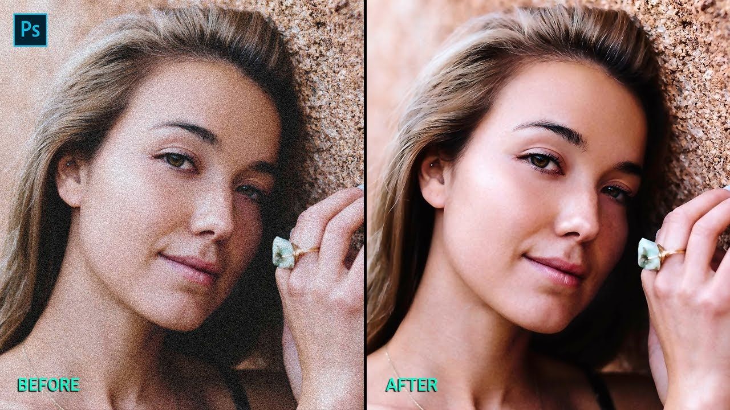
Denoising AutoEncoders
The goal is to remove noise from a signal
We add noise to the images but predict images without the noise.

Slide 19
Python
Notes:
Guidelines
Use a title slide at the beginning of your presentation. There are 9 variations of title slides to choose from.
If you will have a series of slideshows, we recommend using the same style of title slide for each presentation.
Keep your title to no more than 2 lines.
Do not change the font style or font size of the title or subtitle.

